Slide 1


Stress Management Techniques
Prepared by Dr. Rabia Mushtaq

Slide 2
Key Points
01
Stress Management
02
Behavioral Techniques
03
Cognitive Techniques

Slide 3
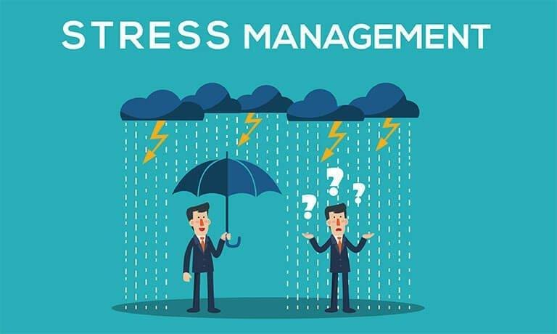

Slide 4
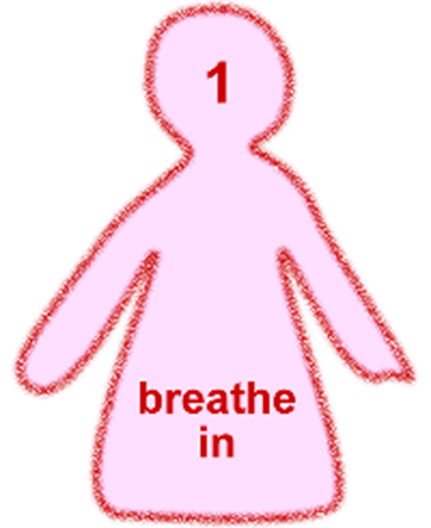
Learn to relax

Slide 5

Find a support system

Slide 6



Be realistic

Slide 7
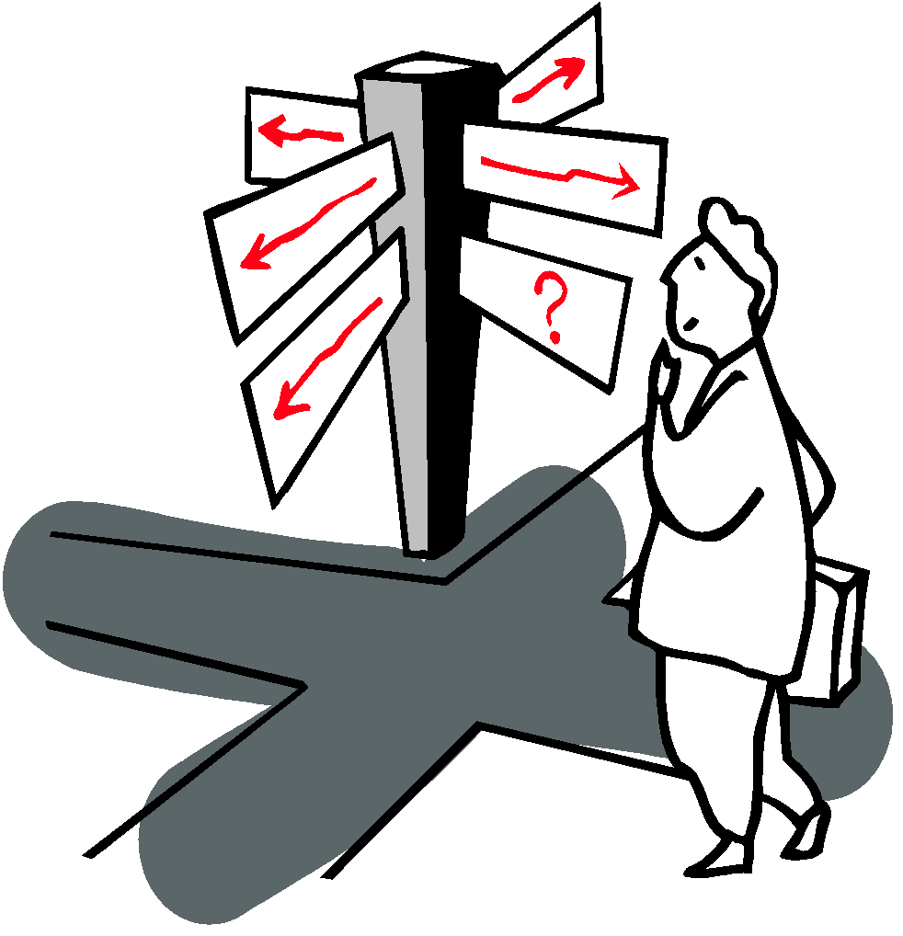
Change your attitude
Find other ways to think about stressful situations.
"Life is 10% what happens to us, and 90% how we react to it."

Slide 8


Gratitude

Slide 9
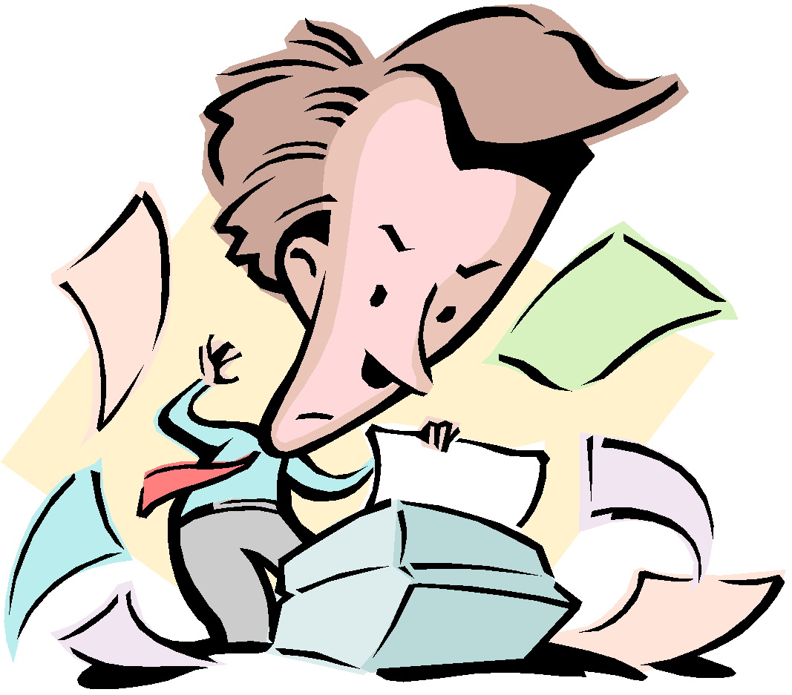

Get organized and take charge

Slide 10

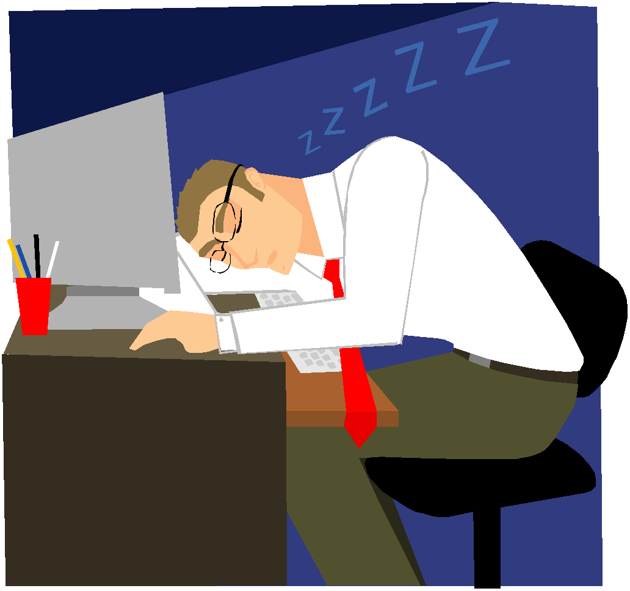

Take breaks, give yourself "me time“

Slide 11


Take good care of yourself
Eat healthy
get regular rest

Slide 12

Learn to say "No"
Learn to pick and choose which things you will say "yes" to and which things you will not.

Slide 13

Regular exercise

Slide 14


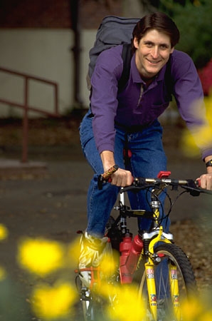
Get a hobby, do something different

Slide 15

Slow down
Know your limits and cut down on the number of things you try to do each day.
Monitor your pace. Rushing through
things can lead to mistakes or poor
performance & more stress.

Slide 16

Laugh, use humor

Slide 17
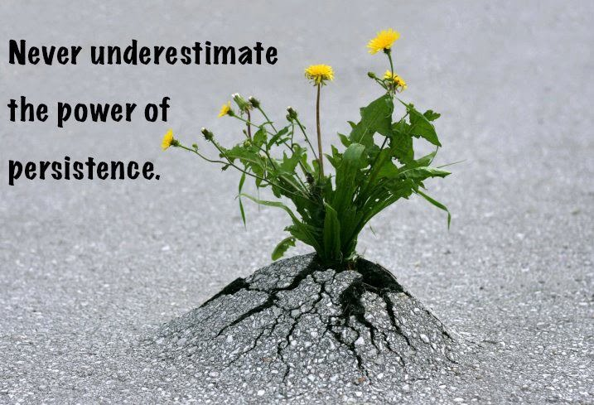
Persistence

Slide 18
CBT
Great Philosopher Epictetus Saying
“People are disturbed not by things but by the views which they take of them”
Beck often quoted that
"we have to take the dark sunglasses of depression off and see the world for the bight, wonderful place it is"

Slide 19
STOPP
S ------- STOP
T-------- TAKE A DEEP BREATH
O-------- OBSERVE
P-------- PUT IN SOME PERSPECTIVE
P-------- PRACTICE WHAT WORKS
Check for REALISTIC thoughts
Re-rate your emotions
CONSULT TIMELY

Slide 20
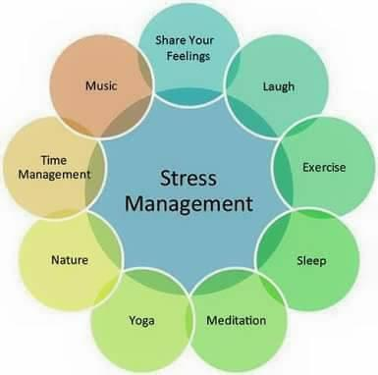

Slide 21
Thank You

